Slide 1
Characterization of the Immune Response to SARS COV-2 in COVID-19

Slide 2
BACKGROUND
On Dec 31 2019 the WHO country office in China was alerted to media reports of an outbreak of atypical pneumonia cases in Wuhan
Jan 9 2020 Chinese officials report that the cases are due to a novel coronavirus
Jan 11 WHO receives genetic sequencies of the novel coronavirus from Chinese officials
Jan 13 Thailand Reports the first lab confirmed case of novel coronavirus outside China
Jan 21 The United States confirms the first case, WHO confirms at least some human to human transmission
June 28 WHO declares a pandemic
Notes:
Mac

Slide 3
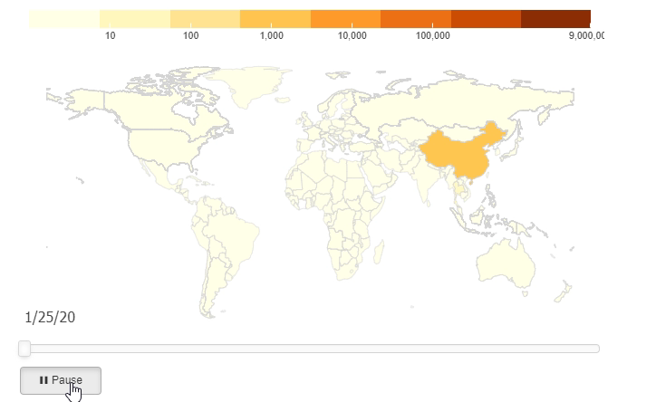
BACKGROUND
Notes:
Mac

Slide 4
WHAT HAPPENED
Basic public health measures failed to keep the spread of this virus located to one region or country due to several complex issues:
Delayed identification of human-to-human transmission
Asymptomatic spread
An increasingly global economy and fast pace of travel across continents.
While some of the most low-tech and effective measures have failed there have been some successes:
Fast sequencing and publication of the genome of SARS-COV-2
Rapid work on the development of a vaccine and therapeutics
Notes:
MAc

Slide 5
Our Study
A protein microarray containing 18 of the 28 predicted proteins from the SARS-COV-2 genome was constructed.
10 proteins were excluded as they could not be purified to an acceptable standard or obtained from commercial sources.
Sera from 28 patients who had convalesced from COVID- 19 were obtained on the day of their discharge.
Notes:
Laila

Slide 6
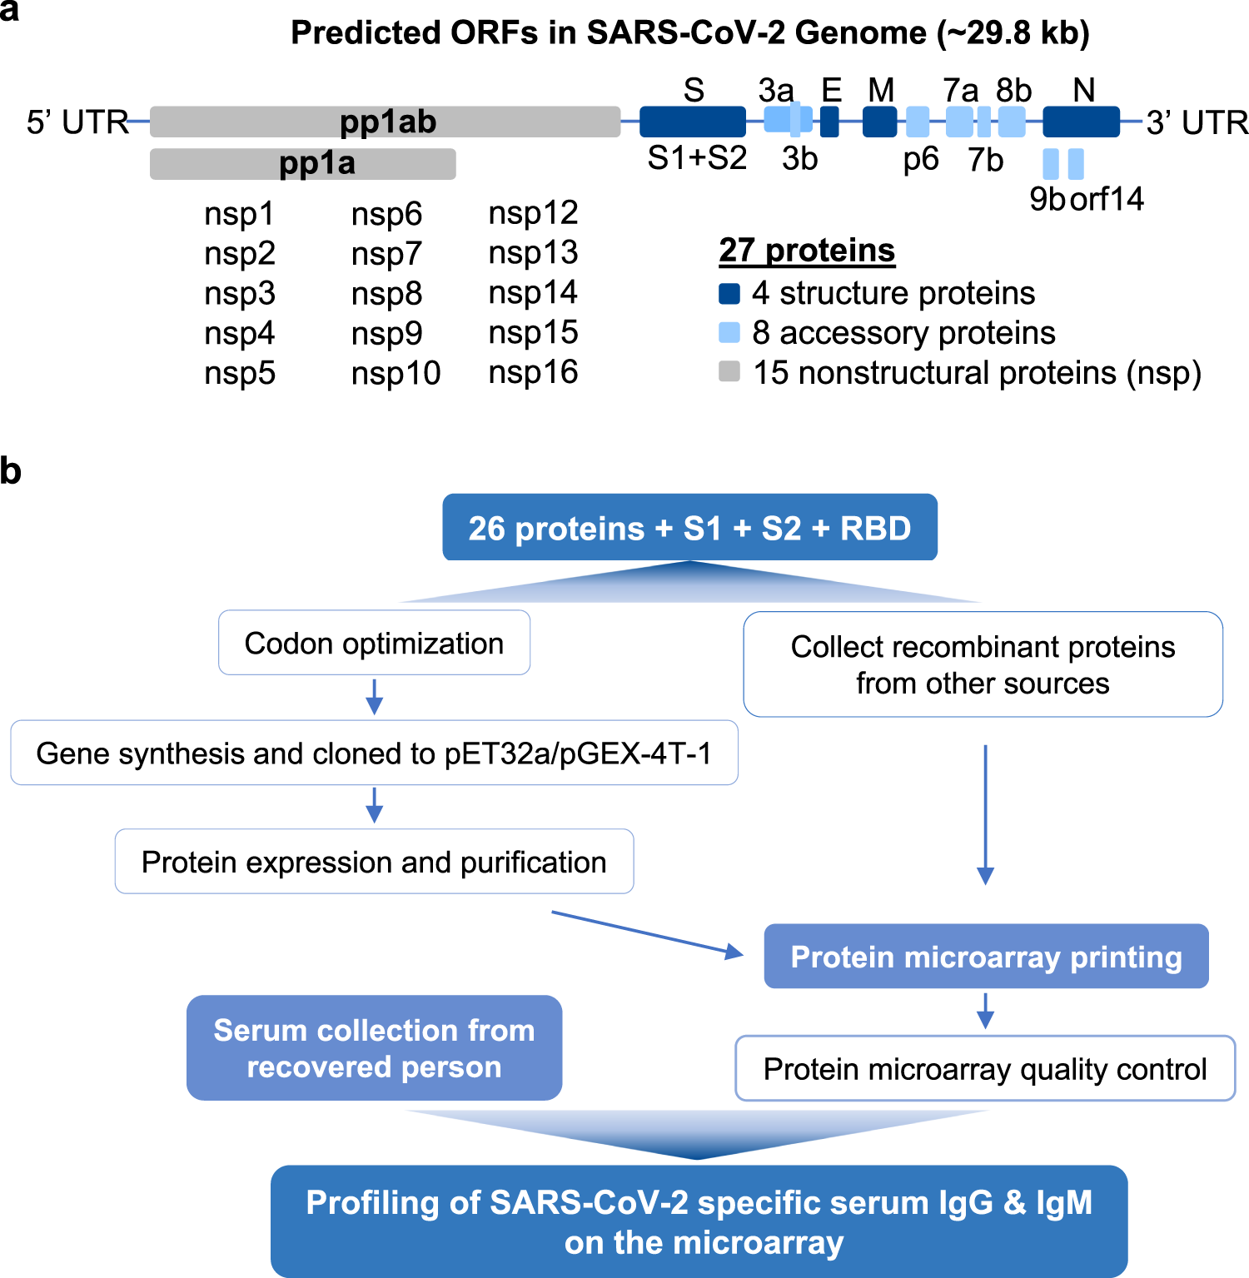
Notes:
Laila

Slide 7
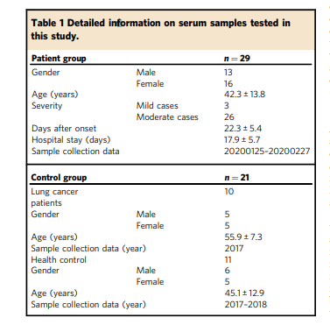
Notes:
Laila

Slide 8
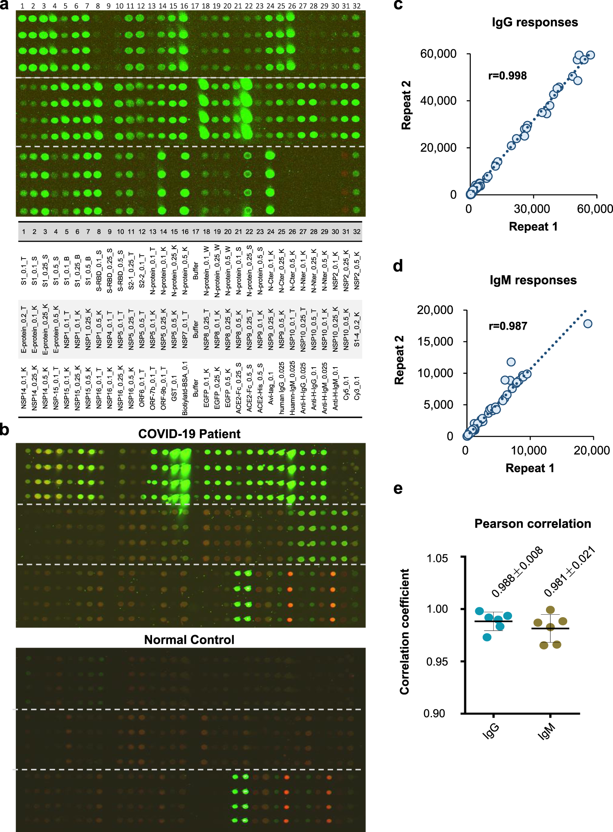
Notes:
Laila

Slide 9
Notes:
Laila

Slide 10
File Types
The proteome microarrays were scanned using the microarray scanner, GenePix
GenePix outputs .gpr file, one .gpr file for each array
One way to analyze the data is to convert the .gpr files to .txt or .xlsx files
Python and R were used for pre-processing the data and converting file types
Notes:
Laila

Slide 11
Preprocessing
In annotation file, added “” to each sample ID
In microarray data files, added column for description of sample and serum sample ID
Aggregated four separate microarray GPR files
Separate into IgG and IgM fluorescence files
Notes:
Emily

Slide 12
Troubleshooting -- maimages
GenePix outputs a ‘targets.txt’ file along with the .gpr files
In the R limma package, the read.maimages function reads in the .gpr files with the ‘targets.txt’
In this case, the ‘targets.txt’ file was not provided in the raw data by the authors of the study
We contacted the authors in an attempt to retrieve this file to continue our analysis
Notes:
Laila

Slide 13
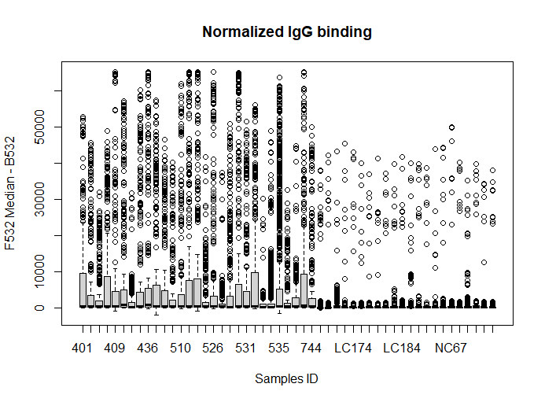
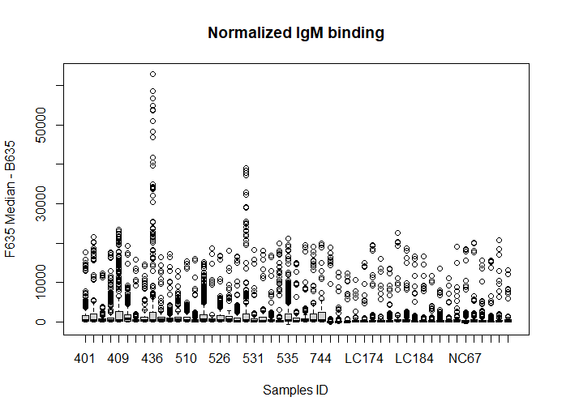
Analysis
Notes:
Emily

Slide 14
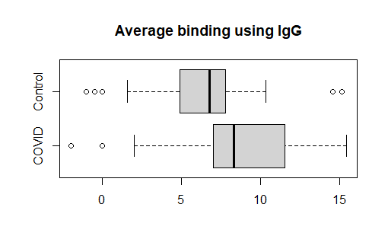
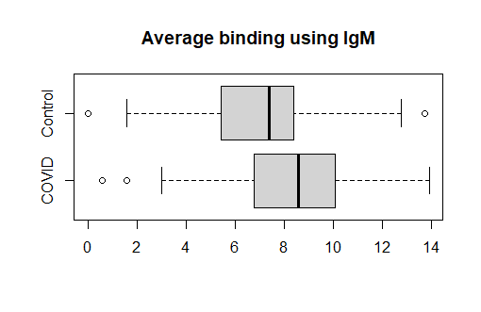
A look at aggregated fluorescence

Slide 15
Analysis of Contaminated Spots

Slide 16
Analyzing “Important” Spots

Slide 17
Our Findings
While we were limited in out reanylsis of the data as described above.
We are able to show clear difference between the degree of IgG and IgM response demonstrated.
When we look at the methods for collection sera for COVID patients, sera was obtained at discharge:
discharge criteria are: (1) Body temperature is back to normal for more than three days; (2) Respiratory symptoms improve obviously; (3) Pulmonary imaging shows obvious absorption of inflammation; (4) Nuclei acid tests negative twice consecutively on respiratory tract samples such as sputum and nasopharyngeal swabs (sampling interval being at least 24 h)
Notes:
MAc

Slide 18
Notes:
Mac

Slide 19
Results
IgG responses against S1 protein were positively correlated with peak lactate dehydrogenase levels and inversely correlated with percentage of lymphocyte, finding which tend to correlate with the severity of illness.
For two of the control sera, strong IgG bindings were observed for N protein.
Notes:
Mac

Slide 20
Opportunities for Further Work
Vaccines:
Immune response to possible vaccine candidate could be characterized in a similar manner and compared to the ummine response to patients in this study.
Therapeutics:
This study suggests that certain antibodies are present aty greater prevalence in the sera of convolecent patients these antibodies or a cocktail there of may represent possible therapeutics
Testing:
This study could be used to identify targets for antibody testing as the differences in the binding from convalescent and normal control serum suggests relative sensitivity and specificity for various targets
Notes:
Mac

Slide 21
References

